Slide 1
Strategic Prevention Framework - Introduction
Program Title Here
date
Notes:
Time – 10 – 15 Mins

Slide 2
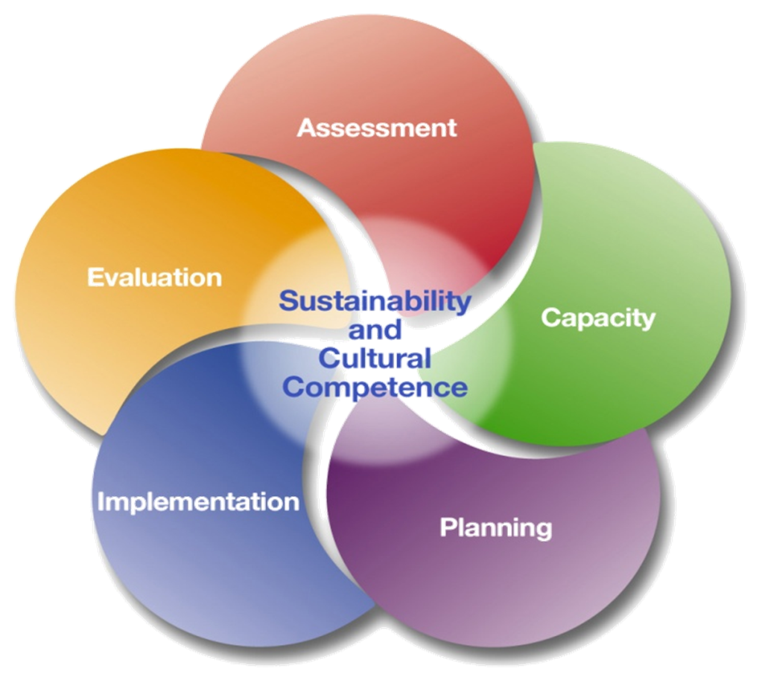
What is SPF?
The Strategic Prevention Framework (SPF) uses a five-step planning process to guide communities in the selection, implementation, and evaluation of effective, culturally appropriate, and sustainable prevention activities.
Notes:
Definition – The SPF uses a five-step planning process to guide communities in the selection, implementation, and evaluation of effective, culturally appropriate, and sustainable prevention activities.

Slide 3
Key Principles of the SPF
It is A Public Health Approach
Notes:
Public Health Approach – focus is on a population or community, rather than on individuals

Slide 4
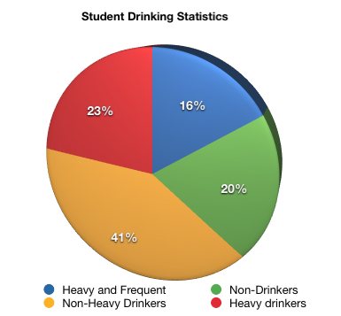
Key Principles of the SPF
It is Data-Driven
Notes:
Data-Driven – Strategies focus on where the need is. Data is collected using local, state, and national data sources. Also, data is collected through interviews and information sessions.

Slide 5
Key Principles of the SPF
It is Community-Based and Owned
Notes:
Community-Based/Owned – Lead by community stakeholders and not a government top down run program.

Slide 6
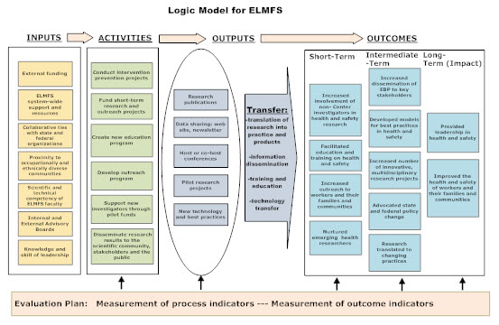
Key Principles of the SPF
It is a Strategic Planning Process
Notes:
Strategic Planning Process – The process is slow, deliberate, and ongoing with the goal of maximum impact for the long-term.

Slide 7
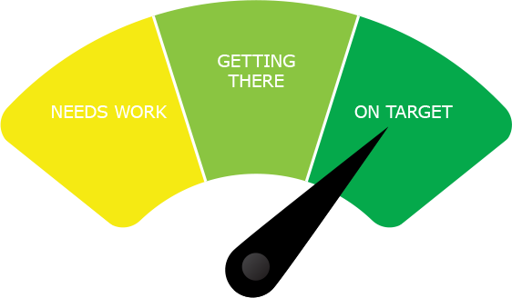
Key Principles of the SPF
It is an Outcomes-Based Prevention Model
Notes:
Outcomes-based – looking to see that it moves the needle for the community

Slide 8
Key Principles of the SPF
It is Culturally Competent & Sustainable
Notes:
Cultural Competent and Sustainable – Each phase takes into consideration cultural aspects of the target population and strategies that are chosen are the ones that have a higher likelihood of being sustained.

Slide 9
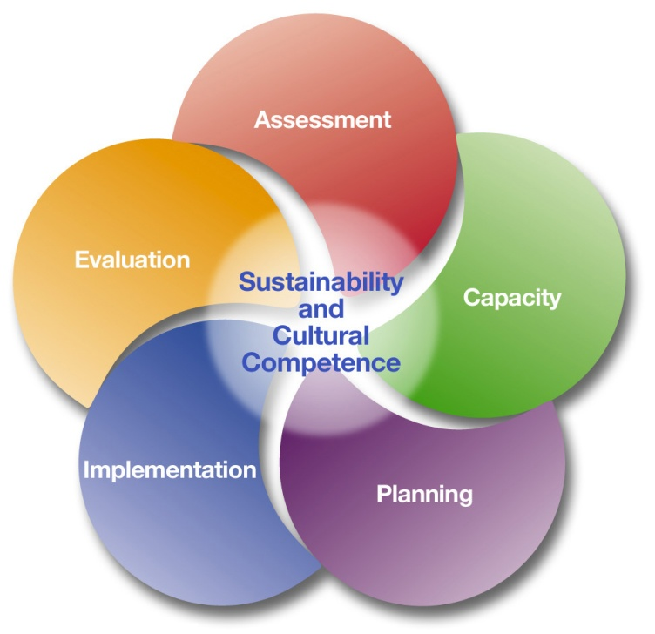
Components of the SPF
Notes:
~~Click to enlarge graphic.
Assessment – Profile population needs, resources, and readiness to address needs and gaps
Capacity – Mobilize and/or build capacity to address needs
Planning – Develop a comprehensive strategic plan
Implementation – Implement evidence-based prevention programs and activities
Evaluation – Monitor, evaluate, sustain, and improve or replace those that fail

Slide 10
Questions?
What is unclear?
Do you understand your role?
Does it make sense?
Notes:
Spend a few minutes asking these questions.

